Slide 1

Methods for Causal Inference in Educational Research
José Manuel Arencibia Alemán
Session 1
Photo by Riho Kroll on Unsplashed

Slide 2

Roadmap
Getting to know each other
Workshop aims and goals
Formalities & Schedule
Oral Exam requirements
Introduction to Causal Inference
Anatomy of Causal Relationships
Potential Outcome Framework
Photo by Taneli Lahtinen on Unsplash

Slide 3


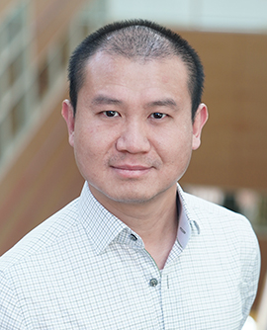
Getting to know each other
José
Tony
You?
Thesis Project?
Previous knowledge of causal inference methods/ theory?
j.m.a.aleman@cemo.uio.no
tony.tan@cemo.uio.no

Slide 4
Workshop aims
Communicating theoretical knowledge about causal and non-causal inference
Causal questions
Experimental designs
Methods
Illustrating methods for causal inference from experimental and observational data
From previous research
Exemplifying applications of the methods on R
Notes:
Importance order
Because / it is a lot of methods to cover. We will get a solid knowledge of the bases

Slide 5
Workshop learning outcomes
Understanding of the potential outcomes framework
Broad knowledge about assumptions, prerequisites, and procedures of randomized control trials, regression models, fixed effect models, instrumental variable approaches, regression discontinuity designs and differences in differences.
Ability to critically read and interpret results of causal inference studies
Applying methodological peculiarities of the causal inference methods in own analyses
Develop Causal inference research questions and approaches

Slide 6

Formalities and Schedule
Required readings (in Canvas / Leganto)
Slides and Materials (in Canvas after each session)
Dates and Place (in Canvas)

Slide 7

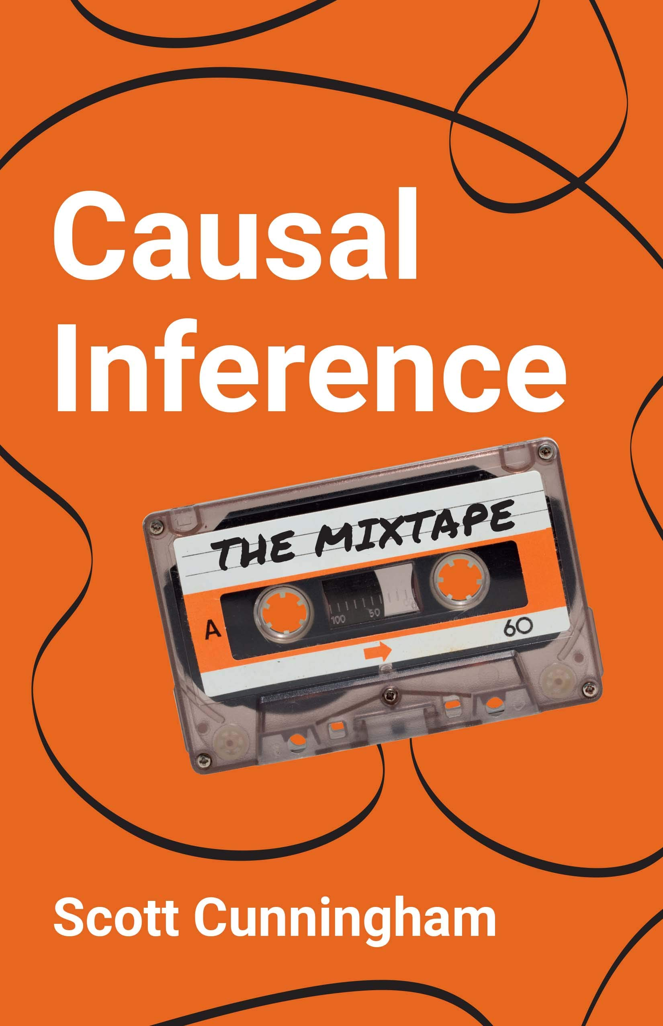
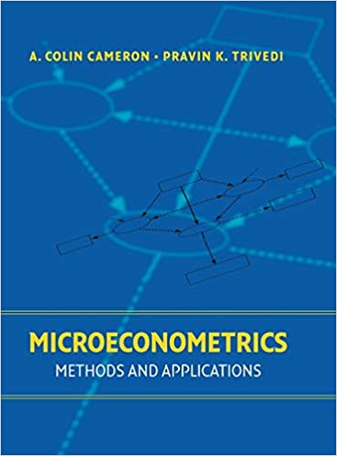
Other recommendations for the specially interested
Angrist, & Pischke, J.-S. (2009)
Cunningham. (2021)
Cameron, & Trivedi, P. K. (2005)

Slide 8
Formalities and Schedule
1 | Introduction Time: 16 August 2022, 12:15-14:00h Main instructor: José Manuel Arencibia Alemán Required reading: Shadish, Cook, & Campbell (2002), chapter 1
2 | Designing Experiments Time: 19 August 2022, 12:15-14:00h Main instructor: Tony Tan Required reading: Shadish, Cook, & Campbell (2002), chapter 8
3 | Randomized Trials Time: 23 August 2022, 12:15-14:00h Main instructor: José Manuel Arencibia Alemán Required reading: Angrist & Pischke (2015), chapter 1
4 | Regression Models Time: 26 August 2022, 10:15-12:00h Main instructor: Tony Tan Required reading: Angrist & Pischke (2015), chapter 2
Notes:
This and the next session, very theoretical/qualitative. From the third session it becomes more methodological/quantitative

Slide 9
Formalities and Schedule
5 | Fixed Effects Time: 30 August 2022, 12:15-14:00h Main instructor: José Manuel Arencibia Alemán Required reading: Huntington-Klein (2022), chapter 16
6 | Fixed Effects / Instrumental Variables Time: 2 September 2022, 10:15-12:00h Main instructor: José Manuel Arencibia Alemán Required reading: H-K (2022), chapter 16; A. & P., chapter 3
7 | Instrumental Variables Time: 6 September 2022, 12:15-14:00h Main instructor: José Manuel Arencibia Alemán Required reading: Angrist & Pischke (2015), chapter 3
8 | Regression Discontinuity I Time: 9 September 2022, 10:15-12:00h Main instructor: José Manuel Arencibia Alemán Required reading: Angrist & Pischke (2015), chapter 4

Slide 10
Formalities and Schedule
9 | Regression Discontinuity II Time: 13 September 2022, 12:15-14:00h Main instructor: Tony Tan Required reading: Steinman & Olsen (2002)
10 | Differences-in-Differences I Time: 16 September 2022, 10:15-12:00h Main instructor: José Manuel Arencibia Alemán Required reading: Angrist & Pischke (2015), chapter 5
11 | Differences-in-Differences II Time: 20 September 2022, 12:15-14:00h Main instructor: Tony Tan Required reading: Strello, Strietholdt, Steinmann & Siepmann (2021)
12 | Lessons Learned Time: 23 September 2022, 10:15-12:00h Main instructor: José Manuel Arencibia Alemán Required reading: Rutkowski & Delandshere (2016)

Slide 11
Assignment requirement (Old)
Written assignment has to be submitted by November 9
Task is to discuss three published empirical articles which use methods for causal inference from non-experimental data
Three articles must be chosen from list
Falch, T., Nyhus, O. H., Strøm, B. (2014). Causal effects of mathematics. Labour Economics, 31, 174-187. (RM)
Fergusson, D. M., McLeod, G. F., & Horwood, L. J. (2014). Unemployment and psychosocial outcomes to age 30: a fixed-effects regression analysis. Australian & New Zealand Journal of Psychiatry, 48(8), 735-742. (FE)
Hanandita, W., & Tampubolon, G. (2014). Does poverty reduce mental health? An instrumental variable analysis. Social Science & Medicine, 113, 59-67. (IV)
Lesik, S. A. (2007). Do developmental mathematics programs have a causal impact on student retention? An application of discrete-time survival and regression-discontinuity analysis. Research in Higher Education, 48(5), 583-608.(RD)
Nye, B., Hedges, L. V., & Konstantopoulos, S. (2000). The effects of small classes on academic achievement: The results of the Tennessee class size experiment. American Educational Research Journal, 37(1), 123–151. (RCT)
Rosén, M. & Gustafsson, J. E. (2016). Is computer availability at home causally related to reading achievement in grade 4? A longitudinal difference in differences approach to IEA data from 1991 to 2006. Large-scale Assessment in Education, 4(5), 1–19. (Diff-in-Diff)

Slide 12
Assignment requirements (Old)
For each study, the report contains:
Summary of the background and motivation of the study (i.e., why was the study conducted, what was the theoretical background, what did the literature review show)
The identification of the causal question investigated in the study (i.e., what are treatment, outcome, and assumed causal mechanism)
Critical discussion of the causal identification approach against the design principles of the respective causal inference method (i.e., what was the statistical approach, in how far were assumptions of the methods met)
Critical summary of the findings of the study (i.e., what were the findings that directly relate to the research question, what were important other findings)
Concluding discussion about the extent to which the causal question was appropriately answered by the study (i.e., were the statistical conclusions valid, were the conclusions internally and externally valid, are there other explanations for the findings, which limitations were and were not discussed by the authors)
Recommendation on how this or future studies could be improved

Slide 13

Assignment requirements (Old)
The written assignment will be evaluated (pass vs. fail) against following criteria:
Structure: The overall report contains a title page and 3 reports on empirical studies from the list below. The 3 reports contain the subsections (1) background, (2) research question, (3) methods, (4) findings, (5) discussion, and (6) literature list.
Scope: Each of the three reports must be limited to 4-5 pages. The overall report is therefore limited to 12-15 pages in addition to the title page.
Readability: The text is in correct and clear, scientific English. Sections have appropriate headings and all abbreviations are introduced.
Format: The format follows the APA standard (see https://apastyle.apa.org/instructional-aids/student-paper-setup-guide.pdf)
File format: The written assignment is submitted as one PDF.

Slide 14
Assignment requirements (Old)
Feedback
Pro:
Great exercise
Con:
Writing was too time consuming; simultaneous with other written assignments
This year proposal (oral exam):
Pro:
Less writing (only presentation slides)
Same content to the exam
Faster feedback
Con:
You have to be at UiO for the exam (written assignment could be sent from anywhere with internet connection)

Slide 15
Oral Exam Requirements
November 9
Goal:
Enable students to demonstrate scientific rigor and solid knowledge about the principles of causal inference and the assumptions, prerequisites, and procedures of methods for causal inference.
Core material:
1 (chosen by the instructors) of 3 papers (chosen by the students) from the list in the course description (in Canvas)
Notice that you still have to draft three presentations (but only make one)!!
Presentation (hard 20 minutes):
Background and motivation
Causal question
Critical assessment of methods
Critical assessment of results and discussion
Future studies recommendations
Questions (10 minutes)
Clarification questions
Principles, assumptions, prerequisites and procedures

Slide 16

Notes:
Questions so far?

Slide 17
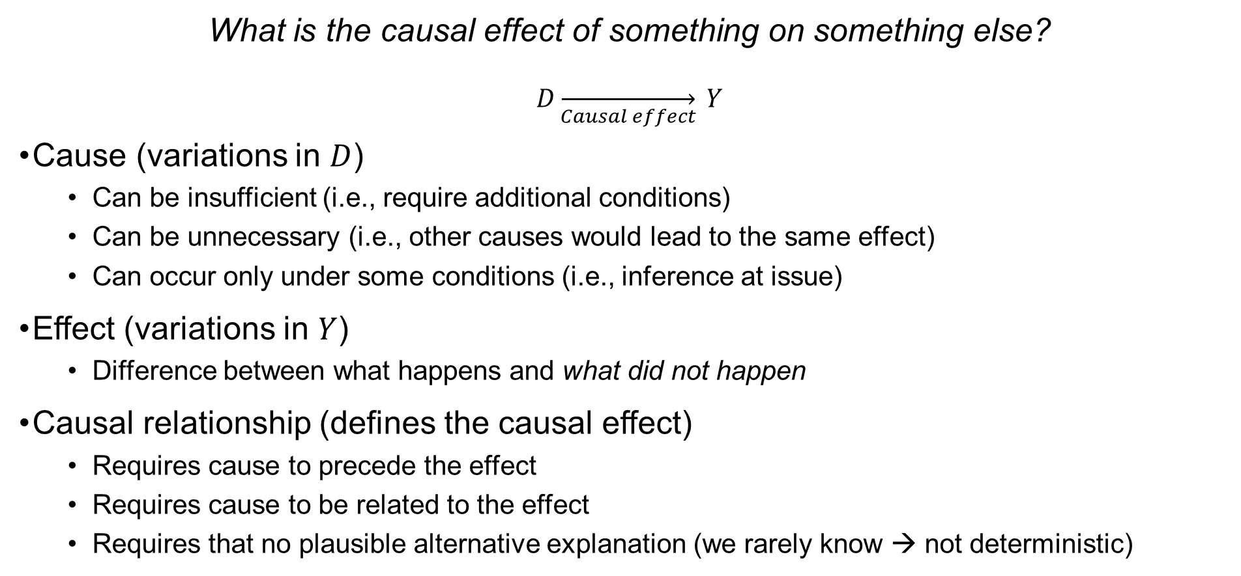
Introduction to Causal Inference
What is the causal effect of something on something else?
$$D\overset{→}{Causal effect} Y$$
Cause (variations in $D$)
Can be insufficient (i.e., require additional conditions)
Can be unnecessary (i.e., other causes would lead to the same effect)
Can occur only under some conditions (i.e., inference at issue)
Effect (variations in $Y$)
Difference between what happens and what did not happen
Causal relationship (defines the causal effect)
Requires cause to precede the effect
Requires cause to be related to the effect
Requires that no plausible alternative explanation (we rarely know → not deterministic)
Campfire example
Notes:
Many theoretical and philosophical underpinnings difficulting to give a right answer (although wrong answers pop up).
Often times, causal effects are equated causal relationships: That is, variation in something else (outcome) due to something (treatment)
In order to not give wrong answers, we need to understand what are causes and effects.
Effect: that which had its beginning from some other thing (cause)

Slide 18

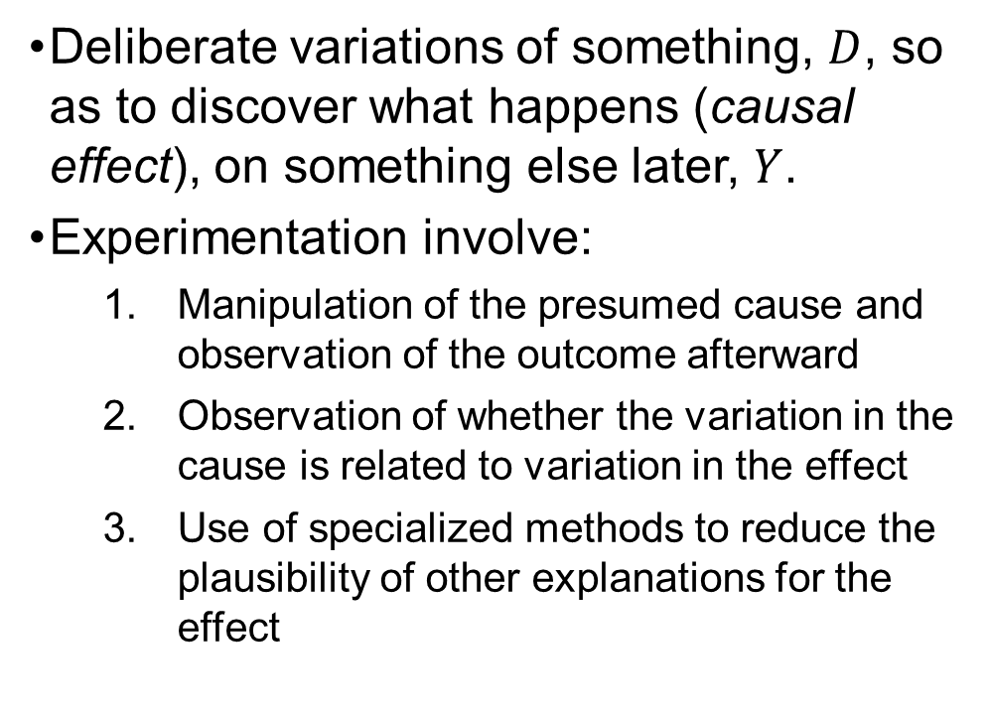
Introduction to Causal Inference
What is an experiment?
Deliberate variations of something, $D$, so as to discover what happens (causal effect), on something else later, $Y$.
Experimentation involve:
Manipulation of the presumed cause and observation of the outcome afterward
Observation of whether the variation in the cause is related to variation in the effect
Use of specialized methods to reduce the plausibility of other explanations for the effect
Photo by Akram Huseyn on Unsplash

Slide 19
Introduction to Causal Inference
What is an experiment?
Causal relationship (defines the causal effect)
Requires cause to precede the effect
Requires cause to be related to the effect
Requires that no plausible alternative explanation (we rarely know → not deterministic)
Deliberate variations of something, $D$, so as to discover what happens (causal effect), on something else later, $Y$.
Experimentation involve:
Manipulation of the presumed cause and observation of the outcome afterward
Observation of whether the variation in the cause is related to variation in the effect
Use of specialized methods to reduce the plausibility of other explanations for the effect

Slide 20
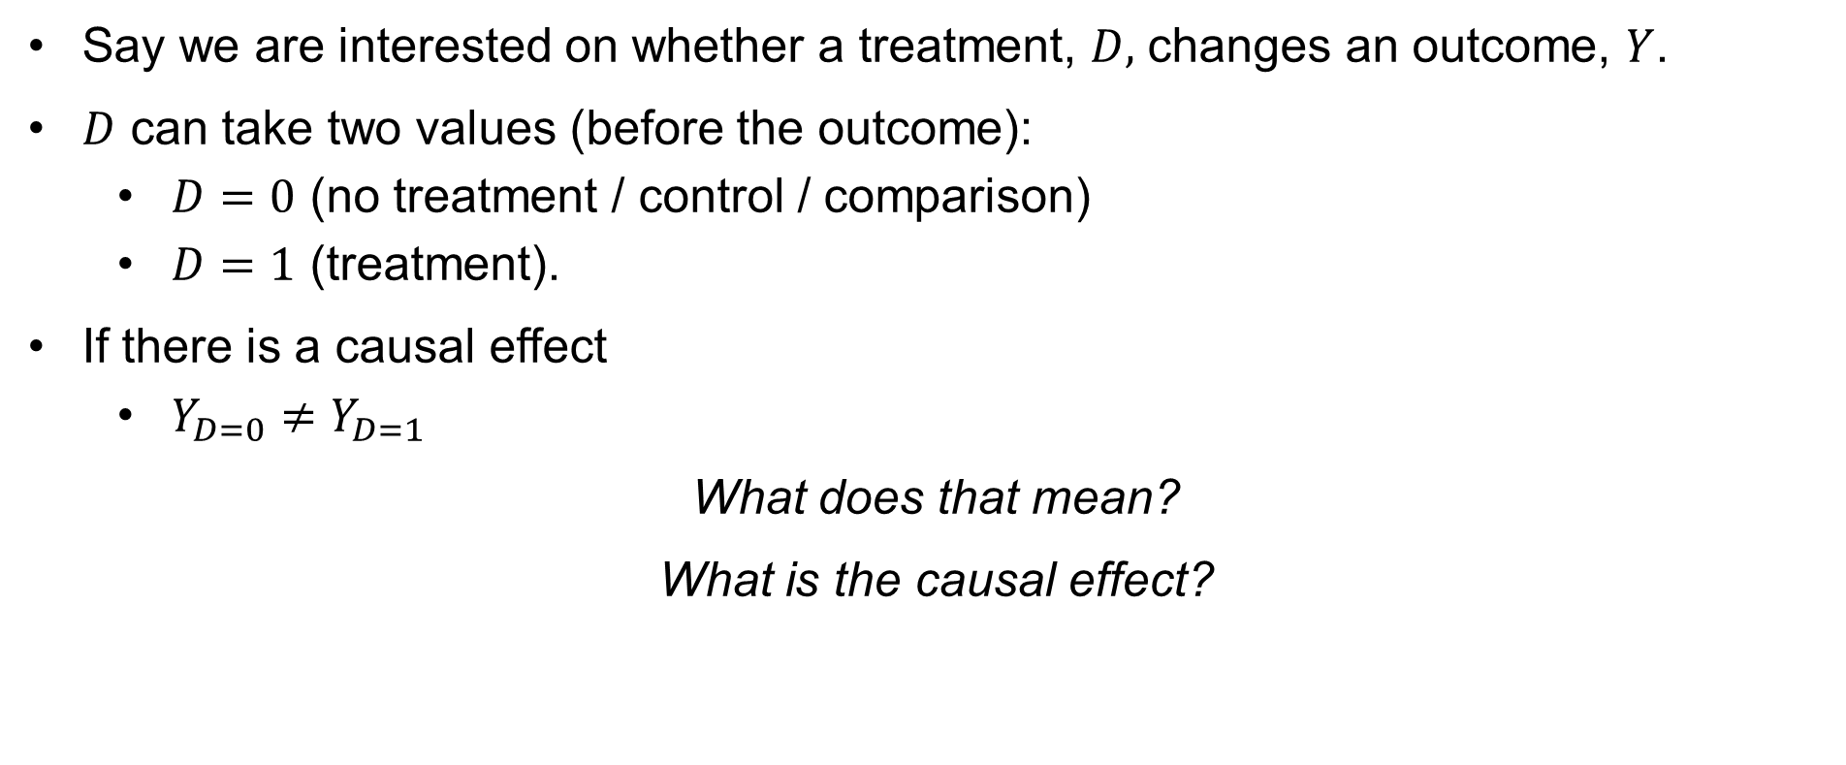
Rubin’s Potential Outcome Framework
Say we are interested on whether a treatment, $D,$ changes an outcome, $Y$.
$D$ can take two values (before the outcome):
$D=0$ (no treatment / control / comparison)
$D=1$ (treatment).
If there is a causal effect
$Y_{D=0}≠Y_{D=1}$
What does that mean?
What is the causal effect?
Notes:
It means that if there is a causal effect, the outcome of treatment is different from the outcome of non-treatment
Is the difference

Slide 21
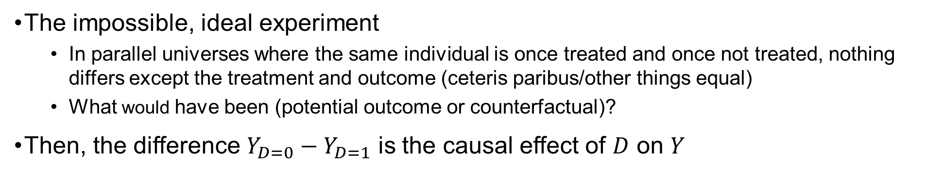
Rubin’s potential outcome framework
with D=0
and Y_{D=0}
with D=1
and Y_{D=1}
The impossible, ideal experiment
In parallel universes where the same individual is once treated and once not treated, nothing differs except the treatment and outcome (ceteris paribus/other things equal)
What would have been (potential outcome or counterfactual)?
Then, the difference $Y_{D=0}−Y_{D=1}$ is the causal effect of $D$ on $Y$
Rubin, 1974

Slide 22
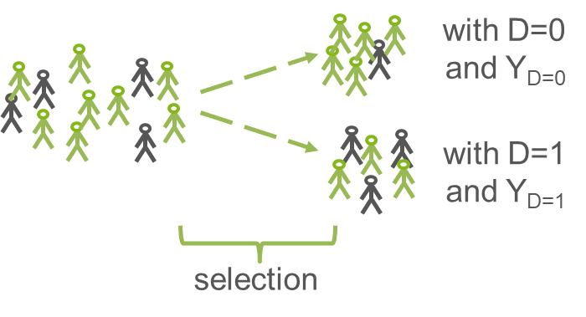
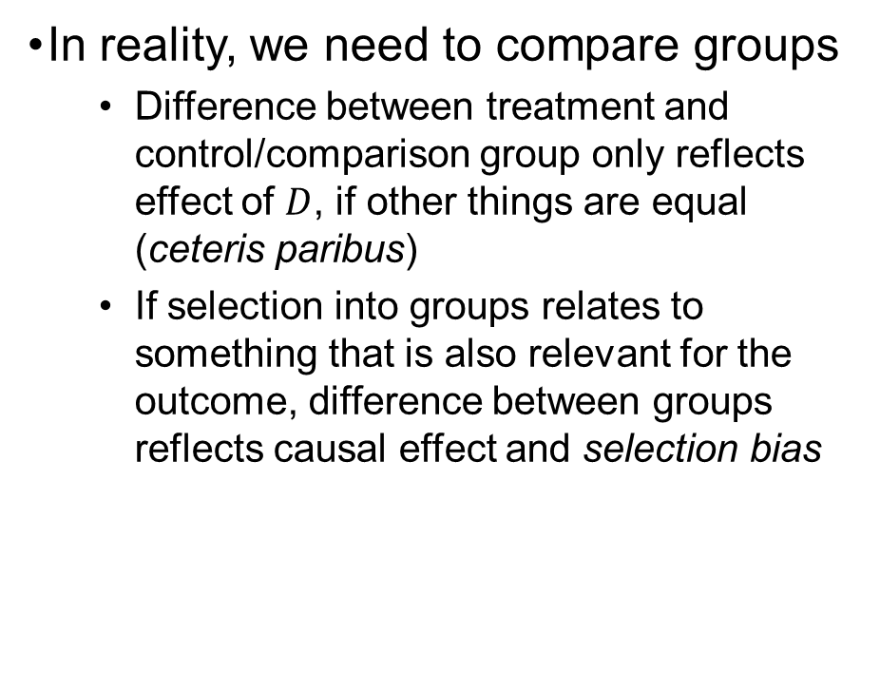
Rubin’s potential outcome framework
In reality, we need to compare groups
Difference between treatment and control/comparison group only reflects effect of $D$, if other things are equal (ceteris paribus)
If selection into groups relates to something that is also relevant for the outcome, difference between groups reflects causal effect and selection bias
Rubin, 1974
Notes:
Next slide example

Slide 23


Rubin’s potential outcome framework
selection
bias!
Example:
Negative correlation between private tutoring and mathematics achievement
Notes:
Ceteris paribus – other things equal? - selection

Slide 24
Notes:
Questions so far?

Slide 25
Correlation ≠ Causation (!)
Why does correlation not prove causation?
maybe we don’t know which variable came first (e.g., reverse causation)
maybe, there is no true association, at all (e.g., spurious correlation)
maybe, there are other explanations (e.g., third-variable effect, confounding, selection bias)
D
Y
D
Y
D
Y
Z

Slide 26


Summing up

Slide 27
Take away messages
Causal Inference is possible if
Plausible causal mechanism
Treatment before outcome
Comparison with counterfactual
Ceteris paribus
Very good counterfactuals and ceteris paribus are difficult to establish
Multiple issues prohibit causal inferences, for example:
Selection bias
Reverse causation
Third-variable bias (or confounding effects)

Slide 28
Formalities and Schedule
1 | Introduction Time: 16 August 2022, 12:15-14:00h Main instructor: José Manuel Arencibia Alemán Required reading: Shadish, Cook, & Campbell (2002), chapter 1
2 | Designing Experiments Time: 19 August 2022, 12:15-14:00h Main instructor: Tony Tan Required reading: Shadish, Cook, & Campbell (2002), chapter 8
3 | Randomized Trials Time: 23 August 2022, 12:15-14:00h Main instructor: José Manuel Arencibia Alemán Required reading: Angrist & Pischke (2015), chapter 1
4 | Regression Models Time: 26 August 2022, 10:15-12:00h Main instructor: Tony Tan Required reading: Angrist & Pischke (2015), chapter 2
Notes:
This and the next session, very theoretical/qualitative. From the third session it becomes more methodological/quantitative

Slide 29
References
Angrist, J. & Pischke, J.-S. (2015). Mastering `Metrics: The Path from Cause to Effect. Princeton University Press
Rubin, D. B. (1974). Estimating causal effects of treatments in randomized and nonrandomized studies. Journal of Educational Psychology, 66(5), 688–701
Shadish, W. R., Cook, T. D., & Campbell, D. T. (2002). Experimental and quasi-experimental designs for generalized causal inference. Mifflin and Company

